Slide 2
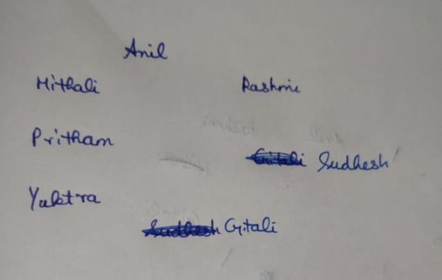
Directions for 1 to 5
Anil, Pritam, Sudesh, Rashmi, Mitali, Gitali and Yukta are sitting around a circle facing the centre.
Anil is third to the left of Yukta, and to the immediate right of Rashmi.
Pritam is second to the left of Gitali who is not an immediate neighbour of Mitali.

Slide 3
1
Who is to the immediate left of Pritam?
A] Mitali
B] Sudesh
C] Yukta
D] Cannot be determined
Answer: A

Slide 4
2
Who is second to the right of Rashmi? (a) Anil (b) Mitali (c) Pritam (d) Sudesh
A] Anil
B] Mitali
C] Pritam
D] Sudesh
Answer: B

Slide 5
3
Which of the following pairs of persons has the first person sitting to the immediate right of the second person?
A] Rashmi - Mitali
B] Anil - Gitali
C] Sudesh - Pritam
D] None of these
Answer:D

Slide 6
4
Which of the following groups has the first person sitting between the other two?
A] Mitali-Anil-Gitali
B] Sudesh-Rashmi-Gitali (Sudhesh is sitting between Rashmi and Gitali)
C] Yukta- Pritam - Rashmi
D] None of these
Answer: B

Slide 7
5
Which of the following is the correct position of Anil with respect to Pritam?
(I) Second to the left (See from Pritham’s view)
(II) Third to the left
(III) Fifth to the right
(IV) Fourth to the right
A] (I) only
B] (II) only
C] Both (I) and (II)
D] Both (I) and (III)
Answer: D

Slide 8
Directions for 6 to 10
Seven Friends Gimi, Harish, Javed, Kandarp, Luv, Moni and Nitin are working in different cities viz. Kolkata, Lucknow, Chandigarh, Gandhinagar, Delhi, Agra, Bhopal not necessarily in the same order.
Each one of them has a different profession from amongst Teacher, Photographer, Auditor, Fashion Designer, Builder, Choreographer and Painter not necessarily in the same order.
1) Harish is a Choreographer and he works in Gandhinagar.
2) Kandarp is a Photographer and he does not work in Kolkata.
3) The Teacher works in Lucknow. --> From 3) and 8) , Nitin is the teacher
4) Moni works in Delhi.
5) The Painter works in Bhopal.
6) Luv is a Builder and he works in Chandigarh.
7) Gimi is a Fashion Designer.
8) Javed does not work in Lucknow.

Slide 9
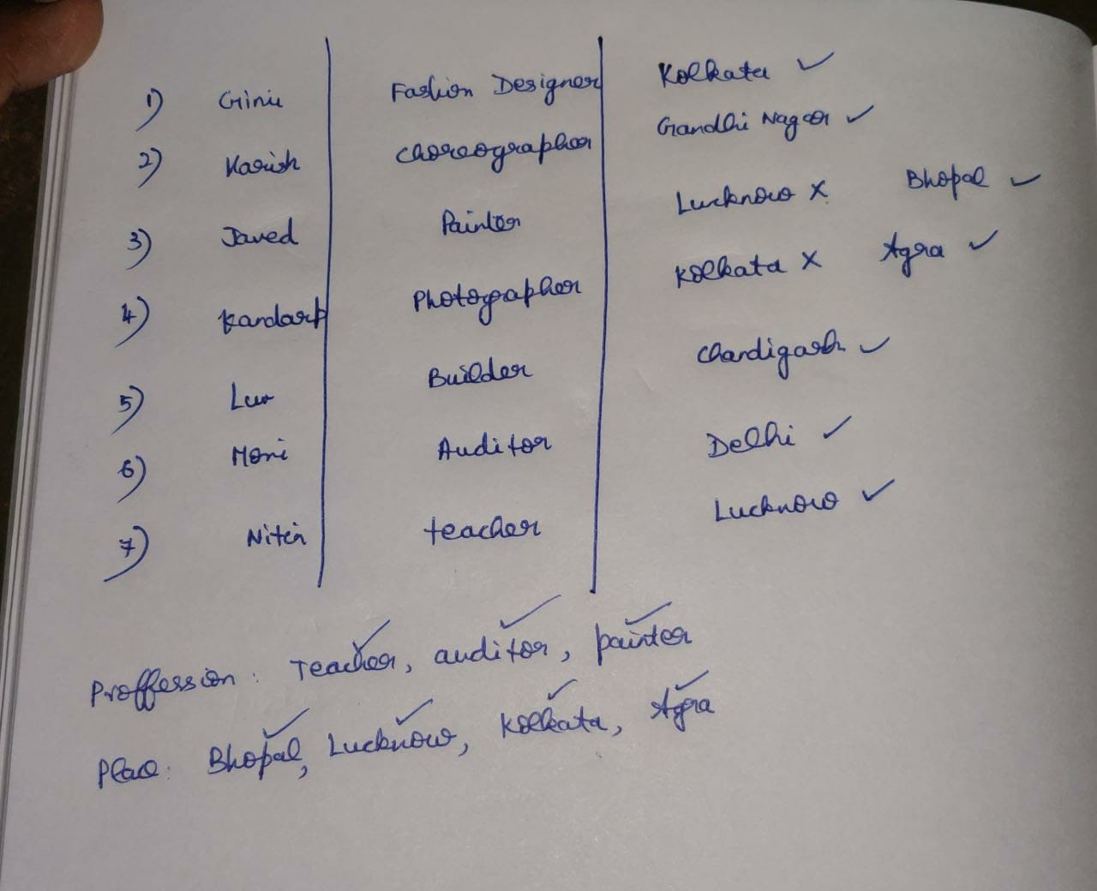

Slide 10
6
Who is the auditor?
A] Javed
B] Nitin
C] Kandarp
D] Moni
Answer: D

Slide 11
7
Which of the following combinations of person, profession and city is definitely correct?
A] Gimi— Fashion Designer— Chandigarh
B] Kandarp— Painter— Bhopal
C] Luv —Builder— Lucknow
D] None of the above
Answer: D

Slide 12
8
Who is working in Lucknow?
A] Javed
B] Kandarp
C] Moni
D] Nitin
Answer: D

Slide 13
9
The Fashion Designer works in which city?
A] Agra
B] Kolkata
C] Lucknow
D] Chandigarh
Answer: B

Slide 14
10
Who is the builder?
A] Nitin
B] Javed
C] Moni
D] None of these
Answer: D

Slide 15
Directions for 11 to 15
Seven officers Lina, Mini, Nita, Pia, Queen, Rita and Sumant work in three different shifts I, II and III with at least two persons working in each shift. Each one of them has a different weekly off from Monday to Sunday not necessarily in the same order. Mini works in the second shift only with Rita whose weekly off is on Friday. Queen’s weekly off is on the next day of Lina’s weekly off and both of them work in different shifts. Pia works in the third shift and her weekly off is on Saturday. Sumant has a weekly off on Monday and he works in the first shift. The one who has a weekly off on Sunday works in the first shift. Lina and Pia do not work in the same shift, Lina’s weekly off is on Tuesday.

Slide 16
11
Whose weekly off falls on Sunday?
A] Lina
B] Mini
C] Cannot be determined
D] None of these
Answer: D

Slide 17
12
Which of the following combinations of shift, person and weekly off is definitely correct?
A] II, Mini, Saturday
B] III, Nita, Thursday
C] III, Pia, Sunday
D] I, Lina, Tuesday
Answer: D

Slide 18
13
Whose weekly off is on Thursday?
A] Lina
B] Mini
C] Nita
D] Queen
Answer: B

Slide 19
14
On which day is Sumant’s weekly off? (a) Monday (b) Wednesday (c) Sunday (d) Tuesday
A] Monday
B] Wednesday
C] Sunday
D] Tuesday
Answer: A

Slide 20
15
Which of the following group of officers work in shift I?
A] Lina, Nita, Sumant
B] Lina, Sumant
C] Nita, Sumant
D] Lina, Pia, Sumant
Answer: A

